Slide 1
CSCI561 FALL 2017 Week 3 Discussion
Prof Sheila Tejada stejada@usc.edu
Prof Wei-min Shen shen@isi.edu
Prof Ning Wang nwang@ict.usc.edu

Slide 2
Graph Search
function GRAPH-SEARCH(problem) returns a solution or failure
frontier ← MAKE-QUEUE(MAKE-NODE(problem.INITIAL-STATE))
explored_set ← empty
loop do
if EMPTY?(frontier) then return failure
node ← REMOVE-FIRST(frontier)
if problem.GOAL-TEST applied to node.STATE succeeds
then return SOLUTION(node)
explored_set ← INSERT(node) for each new_node in EXPAND(node, problem) do if NOT(MEMBER?(new_node, frontier)) and NOT(MEMBER?(new_node, explored_set))
then frontier ← INSERT(new_node)

Slide 3
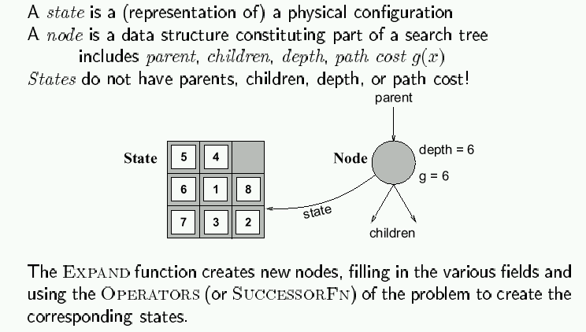
Encapsulating state in nodes

Slide 4
A* = Best-First (past + estimated future)
G₁
n=?
h(i)
c_{i}
i
now
S₀
n-1
c_{j}
j
h(j)
G₂
c_{k}
Past Cost g(n-1)
you know it
k
h(k)
Future Cost
Unknown
Can only estimate h(n)
Never over-estimate!
Is it good to have h(x)=0 for all x?
Chose the best
g(n)+h(n)
G₃

Slide 5
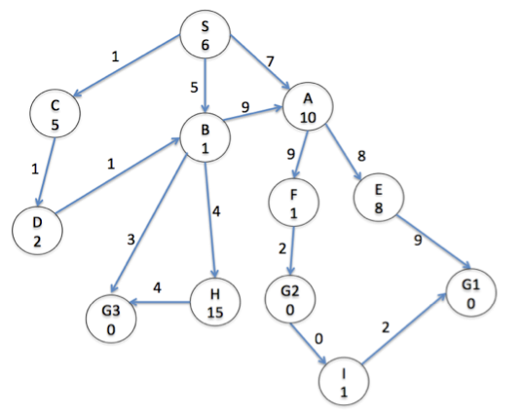
Search with “estimated future cost”
“real cost” are shown on edge
“estimated cost” are inside circle
Notes:
a)DFS G1 (2%) _____ S­A­E­G1 ( 8%) [No partial credit]
b)UCS G3(2%) _____ S­C­D­B­G3( 8%) [No partial credit]
c)A* G3(2%) _____ S­B­C­D­G3 OR S­B­C­D­B­G3 (8%) [No partial credit]

Slide 6
Exercise 3.14
Which of the following are true and which are false? Explain your answers.
Depth-first search always expands at least as many nodes as A∗ search with an admissible heuristic.
h(n) = 0 is an admissible heuristic for the 8-puzzle.
A∗ is of no use in robotics because percepts, states, and actions are continuous.
Breadth-first search is complete even if zero step costs are allowed.
Assume that a rook can move on a chessboard any number of squares in a straight line, vertically or horizontally, but cannot jump over other pieces. Manhattan distance is an admissible heuristic for the problem of moving the rook from square A to square B in the smallest number of moves.
Notes:
False: a lucky DFS might expand exactly d nodes to reach the goal. A∗ largely dominates any graph-search algorithm that is guaranteed to find optimal solutions.
True: h(n) = 0 is always an admissible heuristic, since costs are nonnegative.
False: A* search is often used in robotics; the space can be discretized or skeletonized.
True: depth of the solution matters for breadth-first search, not cost.
False: a rook can move across the board in move one, although the Manhattan distance
from start to finish is 8.

Slide 7
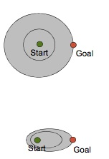
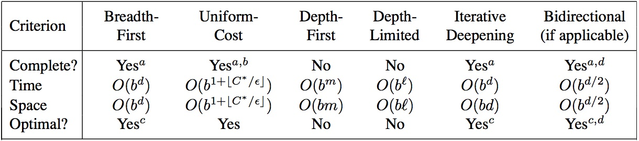
What you should know
UCS
What is the difference between uninformed and informed search? Which ones are optimal?
What are the advantages and disadvantages of depth-first search?
Why does a search heuristic need to be “admissible”?
Be familiar with the differences between search strategies shown in Figure 3.21, and also all informed search
A*
Notes:
http://cse.unl.edu/~choueiry/S03-476-876/searchapplet/
https://courses.cs.washington.edu/courses/cse473/06sp/MazeRunnerDemo/search/applet.html
http://www.briangrinstead.com/files/astar/
http://www.cs.rmit.edu.au/AI-Search/Product/

Slide 8
Want more?
Check out these search comparison demos:
http://cse.unl.edu/~choueiry/S03-476-876/searchapplet/
https://courses.cs.washington.edu/courses/cse473/06sp/MazeRunnerDemo/search/applet.html
A* and heuristics:
http://www.briangrinstead.com/files/astar/
http://www.cs.rmit.edu.au/AI-Search/Product/
Practice Exercises:
Chapter 4: # 4.1
Chapter 6: # 6.1, 6.5

